Slide 1
A Report on
Peer-graded Assignment: Capstone Project - The Battle of Neighborhoods (Week 2)

Slide 2
1. Introduction
The aim of this project is to assistance to people who are planning to open a new restaurant in Toronto to chose the right location by providing data about the income and population of each neighborhood.

Slide 3
2. Data Section
The main data is available from the Toronto city website. To provide the stakeholders the necessary information I'll be combining Toronto's 2016 Census that contains Population, Average income per Neighborhood with Foursquare API to collect competitors on the same neighborhoods.
Toronto's Census data in publicly available at this website: https://www.toronto.ca/city-government/data-research-maps/open-data/open-data-catalogue/#8c732154-5012-9afe-d0cd-ba3ffc813d5a

Slide 4
3. Methodology
Here a new person who is thinking for the investment will be able to find the location of restaurant based on the income, population and other competitors. This is the main method that is employed in the peer graded assignment.

Slide 5
4. Results
Comparing the maps we can notice the majority of the restaurants grouped on main streets and on the south of the city, although some of the wealthiest neighborhoods are up to the north. Also, the areas with a dense population don't reflect on the number of restaurants.

Slide 6
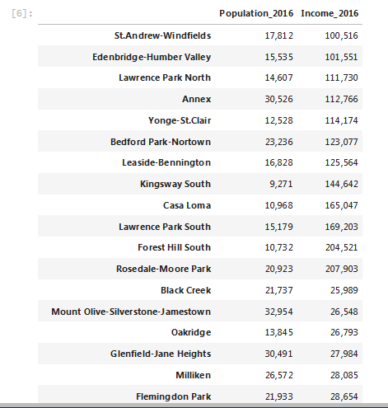
Sample Result (Partial)

Slide 7
5. Discussion
When I first decided to create this study I was expecting to find clusters of restaurants in certain regions and the final result didn't meet that expectation.

Slide 8
6. Conclusion
This report may be helpful for someone planning on opening a restaurant in Toronto, by comparing the current offers and neighborhoods profiles, however it may not cover all variables such as access to public transportation or even the restaurants profiles, so it shall not be used as a single decision making tool.

